Slide 1
Mar 16

Slide 2
Training stats
Applying dr < 1 cut comparing to dr < 1.5 cut, 1.7% loss on sig event, and 44% loss on bkg event
sig_event_loss = 0.017456 sig_event_count = 222387
sig_event_loss = 0.447007 bkg_event_count = 285814
DNN features: 'numOfInDetTracks', 'numOfFatJets', 'numOfInDetTracks_inFJCone’, 'muonPt', 'muonEta', 'fatJetPt', 'fatJetM', 'fatJetD2', 'fatJetEta’, 'jet1Pt', 'jet1M','jet2Pt', 'jet2M’, 'MET’, 'muon_fatjet_dr', 'muon_fatjet_deta', 'muon_fatjet_dphi’, 'muon_jet1_dr', 'muon_jet1_deta', 'muon_jet1_dphi', 'muon_jet2_dr', 'muon_jet2_deta', 'muon_jet2_dphi’, 'muon_MET_dphi', 'fatjet_MET_dphi’ (25 total)
GNN Features: (rel_pt, deta, dphi, dr) * 30

Slide 3
Major Difference
The GNN on reco is not comparable to when we trained it on truth. Possible reason maybe that in truth we used mass to identify particle types but reco we don’t have that.
Consistency: GNN and the transformer performed almost the same

Slide 4
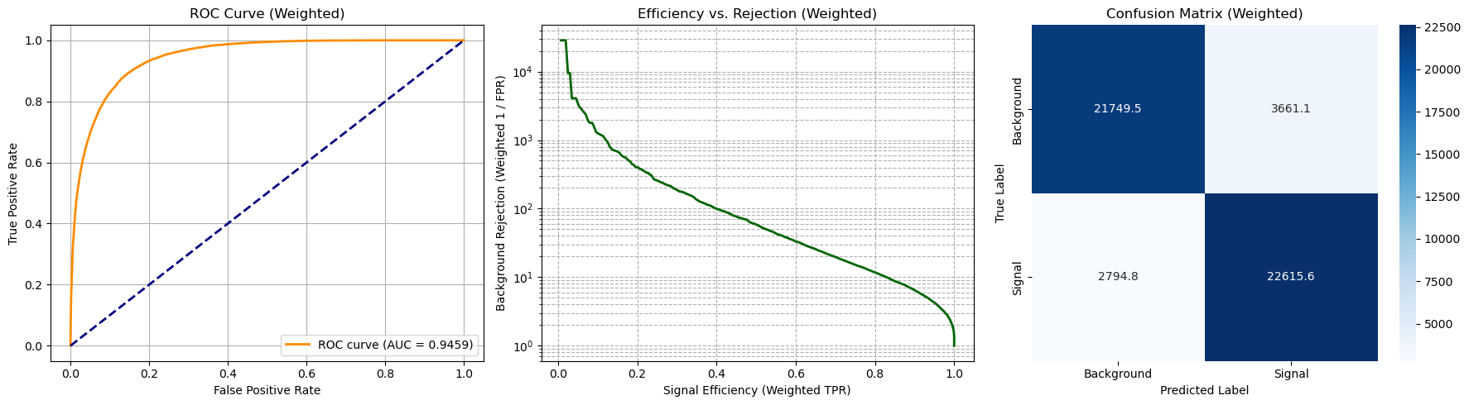
DNN training result

Slide 5
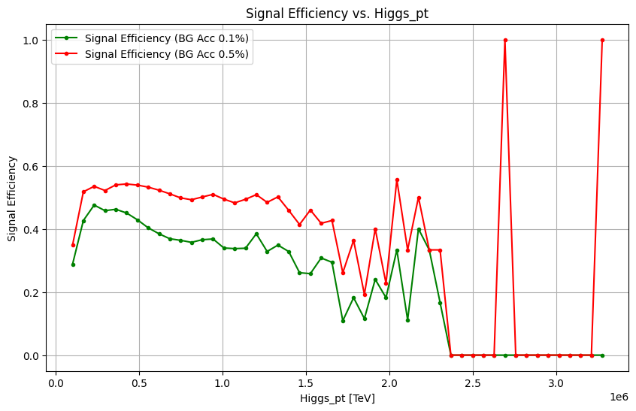
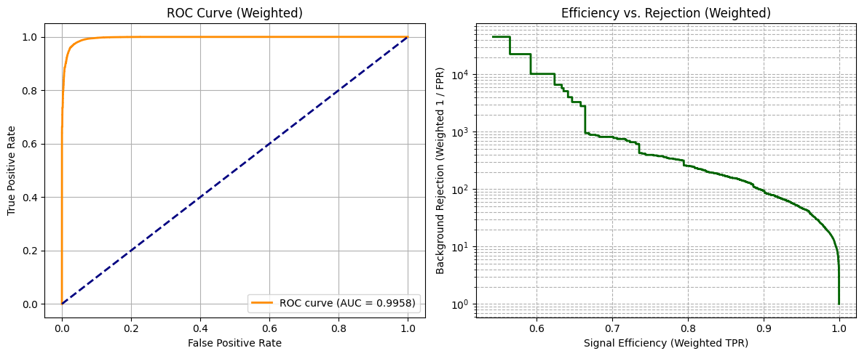
DNN truth results from before:

Slide 6
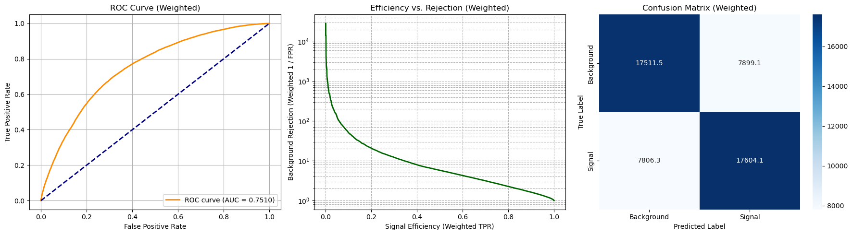
GNN training results

Slide 7
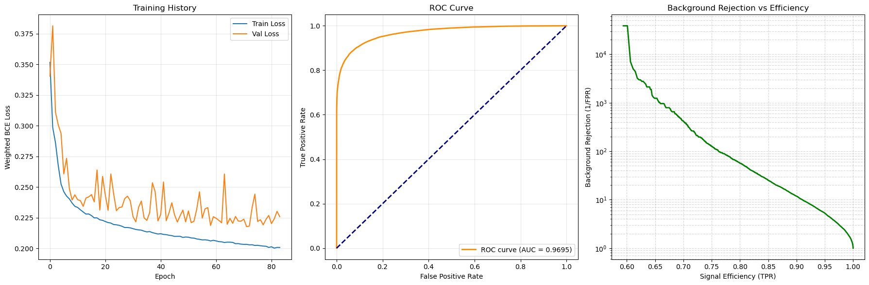
GNN truth result (fjc only, 30 constituents)

Slide 8
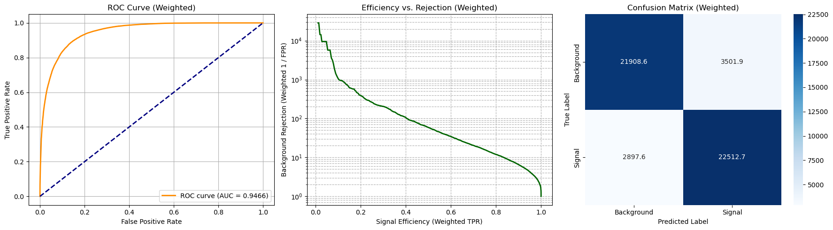
DGNN training results

Slide 9
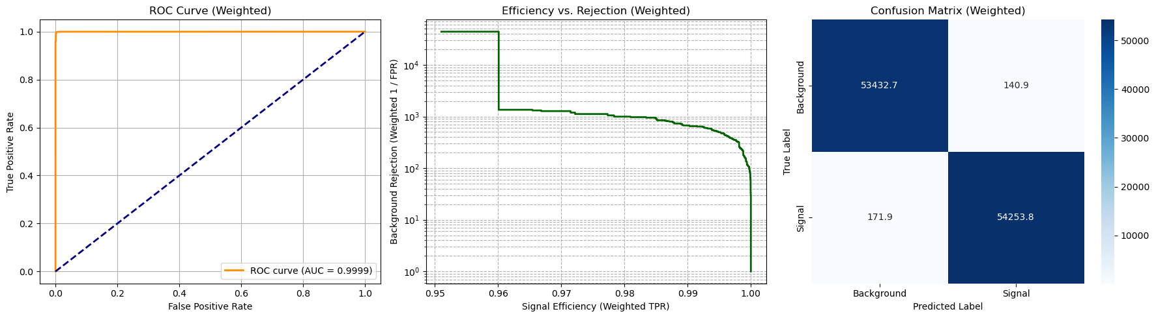
DGNN truth

Slide 10
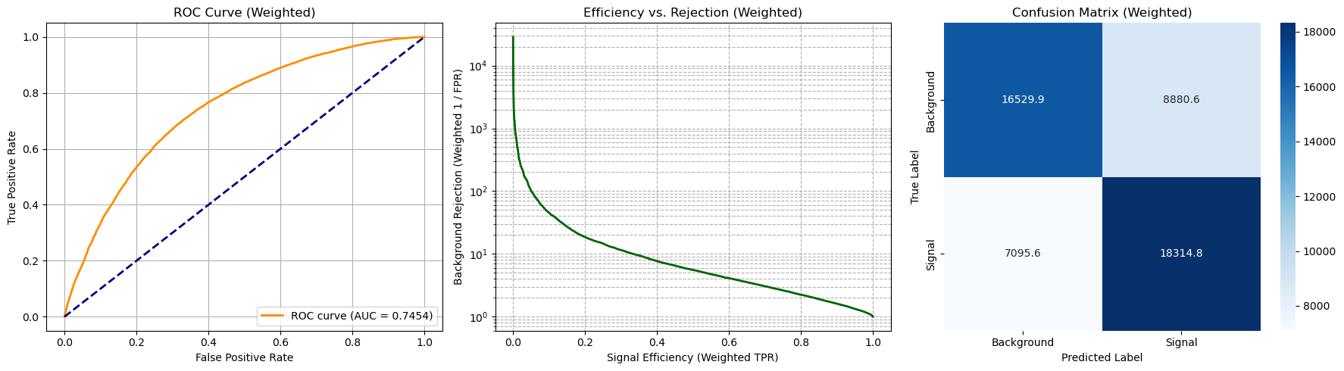
Transformer training results

Slide 11
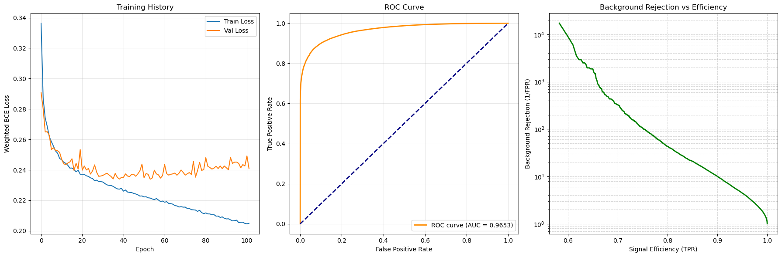
Transformer truth

Slide 12

Transformer + DNN

